Slide 1
Preliminary Theory: Maximum Likelihood Estimation (MLE)
Kyun-Seop Bae MD PhD
Department of Clinical Pharmacology and Therapeutics
University of Ulsan

Slide 2
What follows?
Probability, p: 0 ≤ p ≤ 1
Random Variable: Event → Number
Probability Density Function (pdf)
Likelihood, l: 0 ≤ l < ∞
Maximum Likelihood Estimation (MLE)

Slide 3
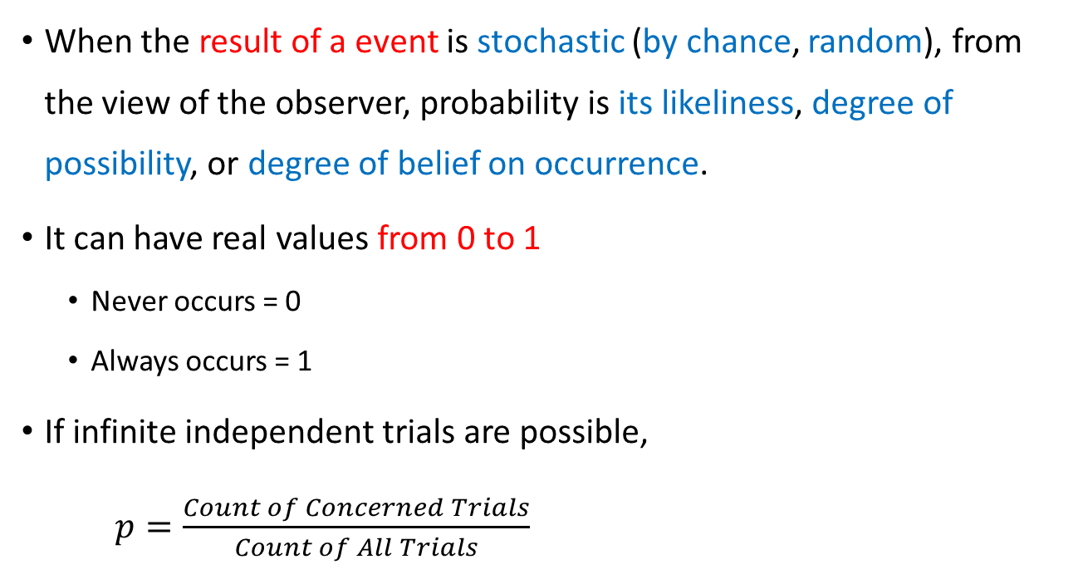
Probability
When the result of a event is stochastic (by chance, random), from the view of the observer, probability is its likeliness, degree of possibility, or degree of belief on occurrence.
It can have real values from 0 to 1
Never occurs = 0
Always occurs = 1
If infinite independent trials are possible,
$p=\frac{Count of Concerned Trials}{Count of All Trials}$

Slide 4
Random Variable (RV)
A kind of mapping from stochastic event to real number
Result of the four fundamental arithmetic on RV is another RV.
Usually it is expressed using (denoted by) English capital characters like X, Y.
Exception: ε for residual, η for inter-individual random variability
Almost all RVs have finite means and standard deviations.
Exception: Cauchy distribution (t-distribution with df=1 or Z1/Z2)
The values occupied (inserted into RV, or results) after observation is expressed (denoted by) using English small characters like x, y.

Slide 5
Basic Operations on RV and their results
E(aX ± bY) = aE(X) ± bE(Y)
V(aX ± bY) = a²V(X) + b²V(Y) ± 2abCOV(X, Y)
COV(X, Y) ≡ E[(X - E(X))(Y - E(Y))] = E[XY - E(X)Y - XE(Y) + E(X)E(Y)] = E(XY) - E(X)E(Y) - E(X)E(Y) + E(X)E(Y) = E(XY) - E(X)E(Y)
Three special operations (functions) for RV which turns RV to values (which no more RV): Expectation (E), Variance (V), and Covariance (COV) -> These are integral (or summation discrete RV) form function.

Slide 6

Statistic: a kind of RV (It usually has mean and SD!)
Statistics (a kind of discipline)
Descriptive Statistics
Mean, SD, Variance, Median, Mode, Maximum, Minimum, …
Inferential Statistics: This uses statistic(s).
Parameter Estimation
Estimator: Statistic for parameter estimation
Estimate: Value of Estimator
Ex:
Hypothesis Test
(Test) Statistic: Statistic for hypothesis test
Ex: Z, T, F, V, …
Statistic: a kind of RV useful in inference
Point Estimate (PE): usually mean or mode of a statistic
Standard Error (SE): standard deviation (SD) of a statistic
$$\overline{X},\overline{x}, S^{2}, s^{2},…$$

Slide 7
Probability Density Function (pdf)
A function for an RV which satisfies the following
For discrete valued event, use Σ (sigma symbol) instead of integral symbol.
This function may be called probability mass function (pmf) for discrete RV.
A pdf for X which is distributed as (follows) normal distribution N(μ,σ²)
Parameter(s): constants which determines the shape of curve
Examples for statistical distribution curve: μ,σ²
What is it that pdf returns? This is not probability. (Hint: its name.)

Slide 8
Likelihood: 0 ≤ l < ∞
With random variable Y, its pdf f(y), and its n observation values, likelihood is defined as
For normal distribution
For discrete RV, likelihood is same to probability.

Slide 9
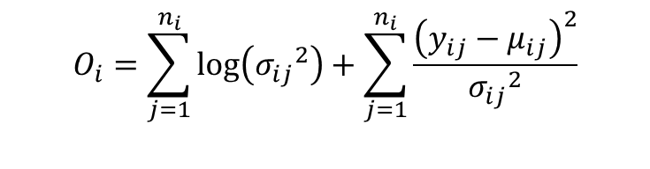
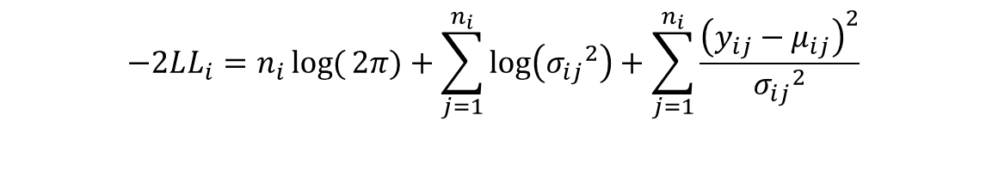
-2 log likelihood (-2LL) & Objective function (OF)
For normal distribution, and for the subject i with ni observations
What is the combination of parameters which minimizes (i.e. maximizes the likelihood) the above function? The result is maximum likelihood estimator/estimate (MLE) and its objective function is
$$−2LL_{i}=n_{i}\log{(}2π)+\sum_{j=1}^{n_{i}}{\log\left({σ_{ij}}^{2}\right)}+\sum_{j=1}^{n_{i}}{\frac{{\left(y_{ij}−μ_{ij}\right)}^{2}}{{σ_{ij}}^{2}}}$$
$$O_{i}=\sum_{j=1}^{n_{i}}{\log\left({σ_{ij}}^{2}\right)}+\sum_{j=1}^{n_{i}}{\frac{{\left(y_{ij}−μ_{ij}\right)}^{2}}{{σ_{ij}}^{2}}}$$

Slide 10
Maximum Likelihood Estimation (MLE)
An estimation method that finds a combination of parameters which maximizes the likelihood of an observation dataset
For normal distribution
Cf)

Slide 11
Desirable properties of an estimator A for the parameter α
Unbiasedness
Consistency
Minimum Variance (Efficiency)
Cf) MVUE, BLUE/BLUP

